Slide 1


www.cic.com
DETECTING DNS OVER HTTPS (DOH) TRAFFIC USING MACHINE LEARNING
Identifying DoH Traffic
for Improved Network Security
Presented by
Ayoub Moubiden - Osaid AlHawamdeh
Mohammed Al-Ashqar - Bashar Rasheed

Slide 2






Project Overview
Problem:
DNS over HTTPS (DoH) hides DNS requests in encrypted traffic, making detection harder.
Objective:
Build machine learning models to classify DoH and Non-DoH traffic.
Why it Matters:
Prevent misuse of DoH for malicious activities and enhance network securityc.

Slide 3




Dataset Description
Dataset Names:
CIC DoH Dataset (2020) and CIC DoHBrw-2020
Source: University of New Brunswick
Attributes:
Source IP, Destination IP
Packet size, Packet count
Protocol type, Flow duration, DNS query length
Classes: DoH and Non-DoH traffic

Slide 4



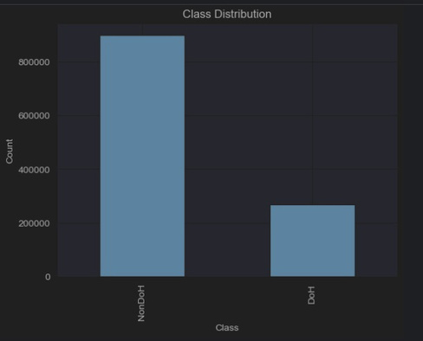



Dataset Details
Class Distribution:
Balanced or imbalanced?
DoH Traffic:
Encrypted DNS traffic hidden in HTTPS.
Non-DoH Traffic:
Regular DNS traffic.
Size:
1100000 records and 34 features

Slide 5
Data Preprocessing
Why Preprocess? To clean and prepare the data for analysis.
1
2
3
4
Handle missing values (e.g., fill with median).
Remove unneeded columns (e.g., timestamps, IPs).
Standardize numerical features (e.g., packet size, flow duration).
Detect and handle outliers using IQR (Interquartile Range)

Slide 6


Feature Selection
Goal: Pick the most important features to improve accuracy.
Method Used: Information Gain.
Selected Features:
Top 10 features based on information gain.
Examples: DNS query length, flow duration, packet size.

Slide 7

Model Overview
Models Used
Naive Bayes
Logistic Regression
Why These Model?
Simple and fast
Why These Model?
Provides probabilities.
Decision Tree
Why These Model?
Easy to understand and interpret.

Slide 8


Metrics Used
Recall
Confusion Matrix
Accuracy
Model Evaluation
F1-Score
Precision

Slide 9
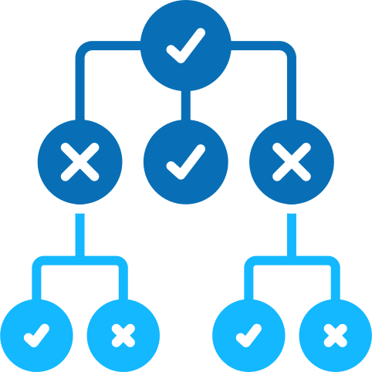
Decision Tree
Key Findings
Achieved perfect accuracy of 1.0.
Both precision, recall, and F1-score for classes 0 and 1 were perfect (1.0).
The confusion matrix shows no misclassifications.
Insight
While the performance appears excellent.

Slide 10

Logistic Regression
Key Findings
Accuracy of 0.77, close to Naive Bayes.
Class 0 was poorly predicted (precision, recall, and F1-score all 0.00), meaning all class 0 instances were misclassified.
The model performs well on class 1, with precision, recall, and F1-score at 0.77 or higher.
Insight
This model struggles to predict minority classes. The preprocessing helped improve accuracy, but more attention is needed for class imbalance handling.

Slide 11

Naive Bayes
Key Findings
Achieved an accuracy of 0.78.
Class 1 predictions were strong (precision, recall, and F1-score of 0.87).
Class 0 was poorly predicted (recall of 0.05, F1-score of 0.09).
Insight
The model performed better than Logistic Regression for class 0 but still failed to adequately balance predictions between the classes.

Slide 12

General Insight
Preprocessing significantly improved model performance:
Balancing data and/or feature engineering helped in all cases.
Handling class imbalance and improving predictions for the minority class (class 0) is essential, especially for Logistic Regression and Naive Bayes.

Slide 13


Challenges Faced
Class Imbalance
High Dimensionality
Handled with feature selection and scaling.
Reduced using mutual information

Slide 14

Conclusion
Main Finding
Future Work
Impact
Machine learning models can effectively detect DoH traffic
Test with ensemble methods like Random Forest or XGBoost.
Deploy models for real-time traffic analysis.
Improves detection of malicious activities in encrypted traffic

Slide 15


References
Datasets
Scikit-learn Documentation
https://www.unb.ca/cic/datasets/dohbrw-2020.html
https://scikit-learn.org/

Slide 16


Questions

Slide 17





Thank you for your attention
Ayoub Moubiden
Osaid AlHawamdeh
Mohammed Al-Ashqar
Bashar Rasheed

